Slide 1



Efficient Distributed Load Balancing for Parallel Algorithms
Biagio Cosenza
Dipartimento di Informatica
Università di Salerno, Italy
Supervisor
Prof. Vittorio Scarano

Slide 2
Outline
Introduction
The Load Balancing Problem
  Centralized vs Distributed approach
Scenarios
  Mesh-based Computations
  Parallel Ray Tracing
  Agent-based Simulations
Conclusion

Slide 3
Introduction to
Parallel Computing
The need of parallel computing
Three walls
  Power wall
  Memory wall
  Instruction Level Parallelism wall
New hardware trends
  From multi-core to many-core
  Low single-core frequency
Reconsidering metrics
  Scalability
Notes:
Power wall let us deduce the opposite: power is expensive, but transistors are free. Hence, we can put more transistors on a chip than we have the power
to turn on. This forces us to concede the battle for maximum performance of individual processing elements, in order to win the war for application efficiency
through optimizing total system performance.
The Memory wall, i.e. the growing disparity of speed between CPU and memory outside the CPU chip [108], would become an overwhelming bottleneck
in computer performance and it will change the way to optimize programs.
Thus, multiply is no longer considered a harming slow operation, if compared to load and store.
Similarly, there are diminishing returns on finding more ILP [55].
*Old belief: less than linear scaling for a multi-processor application is failure
This is no longer true
Any speedup is ok!

Slide 4
Decomposition/Mapping
Decomposition:
  subdivide the computation in tasks
Mapping
  assing tasks to processors
t₁
t₂
t₃
t₄
p₁
p₂
p₃
p₄

Slide 5
The Load Balancing Problem
The execution time of a parallel algorithm
  on a given processor is determined by the time required to perform its portion of the computation + communication/sync overhead
  as a whole is determined by the longest execution time of any of the processors
Balance the computation and communication between processors in such a way that the maximum per-processor execution time is minimal

Slide 6
Load Balancing
An Example
Embarassingly parallel (no dependency)
Different per-task computation time
2 processors, and 4 tasks
t₁
t₂
t₃
t₄
p₁
t₁
t₂
p₂
t₃
t₄

Slide 7
Load Balancing
An Example
p₁
t₁
t₂
p₂
t₃
t₄
p₁
t₁
t₃
p₂
t₂
t₄

Slide 8
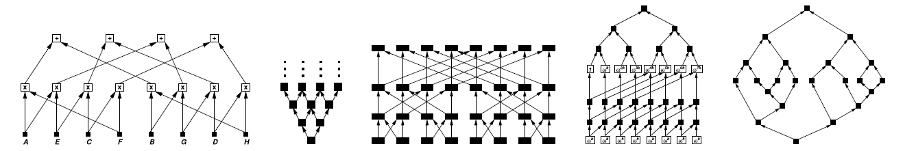
Load Balancing
Non-trivial Scenario
Complex task dependecies
Higher per-task compute time variance
Computational time hard to predict
t₁
t₂
t₃
t₄
Notes:
Data-dependency dags for five familiar computations:
recursive matrix multiplication, a wavefront computation, the Fast-Fourier Transform (FFT), the discrete Laplace transform, a divide-and-conquer computation

Slide 9
Load Balancing
Static vs Dynamic
Task distribution
  …before execution (static)
  …during execution (dynamic)
Notes:
Static load balancing makes the tasks distribution before
execution according to the information of the system workload. Such a decision
may not apply to a dynamical environment. Dynamic load balancing, on the
other hand, makes more informative load balancing decisions during execution
by the runtime state information. In general, dynamic approaches result in
24
1.3. PREVIOUS WORK
better performance.

Slide 10
Load Balancing
Centralized vs Distributed
Centralized
master
workers
Distributed
workers

Slide 11
Load Balancing
Centralized vs Distributed
Master node is a bottleneck
Poor scalability
Global vision of the computation
  Smarter load balancing algorithms
No master syncronization
Good scalability
Local vision of the computation
  Load balancing algorithm can use only local informations
Notes:
multi-core and many-core architectures => scalability is more and more important

Slide 12
Scenarios
Mesh-based computation by using a PBT
  centralized
  complex use of prediction
Load balancing based on cost evaluation
  use of both centralized and distributed techniques
  complex use of prediction
Agent-based simulations
  totally distributed
  simple and fast use of prediction

Slide 13

1. Load Balancing on
Mesh-like Computations
  Load Balancing in Mesh-like Computations using Prediction Binary Tree
Experiences with Mesh-like computations using Prediction Binary Trees. Gennaro Cordasco, Biagio Cosenza, Rosario De Chiara, Ugo Erra, and Vittorio Scarano.
Scalable Computing: Practice and Experience, Scientific international journa l for parallel and distributed computing (SCPE), 10(2):173–187, June 2009.
On Estimating the Effectiveness of Temporal and Spatial Coherence in Parallel Ray Tracing.
Biagio Cosenza, Gennaro Cordasco, Rosario De Chiara, Ugo Erra, and Vittorio Scarano. In 6th Eurographics Italian Chapter Conference (EGITA 2008), July 2-4, Salerno, Italy, 2008.
  Project HPC-Europa++
    Tests ran at HLRS, Universitaet Stuttgart

Slide 14
Mesh-like Computation
A graph G=(N,E) is used to model a computation (computation-graph):
  Each node v ∈ N represents a task in the computation
  Edge among nodes represents tasks dependencies
We consider Mesh-like computation where the graph G is a 2-dimensional mesh

Slide 15
Tiled Mapping Strategies
We are interested in tiled mapping strategies where the whole mesh is partitioned into tiles (contiguous 2-dimensional blocks of items).
Tiled mapping allows to exploit the local dependencies among tasks:
  Locality of interactions
  Spatial coherence

Slide 16
Step-wise computations
Data is computed in successive phases
  Temporal coherence: The amount of time required by the tile p in phase f is comparable to the amount of time required by p in phase f+1
Phase f
Tile p
Phase f+1

Slide 17
Our Proposal
A semi-static coarse-grained decomposition/mapping strategy for parallel mesh-like computation which exploits temporal coherence
  semi-static: decisions are made before each computing phase
  coarse-grained: to reduce communication and exploit the local dependencies among tasks
  mesh-like: the strategy is based on tiled mapping
  temporal coherence is exploited in order to balance task sizes

Slide 18
The Prediction Binary Tree (PBT)
The PBT is in charge of directing the tiling-based mapping strategy:
  Each computing phase is split into m tiles
  Each leaf of the PBT represents a tile

Slide 19
The Prediction Binary Tree (PBT)
Before each new phase tile sizes are adjusted according to the previous phase
heavy task
light tasks

Slide 20
The Prediction Binary Tree (PBT)
Before each new phase tile sizes are adjusted according to the previous phase
Improved balancing

Slide 21
The Prediction Binary Tree (PBT)
Formally
  A PBT T stores the current tiling as a full binary tree
114
120
140
125
180
125
80
80

Slide 22
PBT Update
114
120
140
125
180
125
80
80

Slide 23
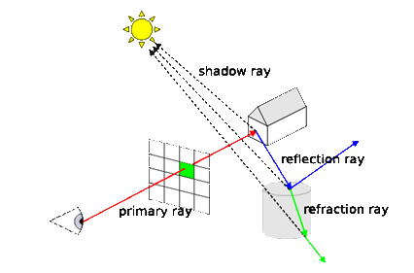
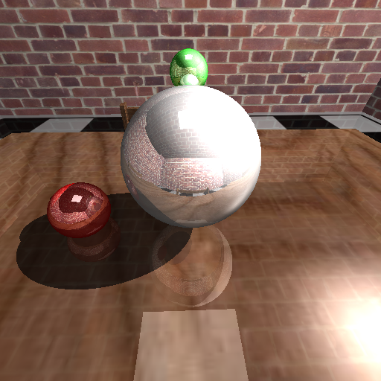
An example:
Ray Tracing Algorithm
for each pixel
for each sample
  ray object intersection
  lighting
  for each reflection/refraction rays direction
  integration for a sample
integration for a pixel
loop
Notes:
Simple form of RT
Components of the RT algorithm
Primary rays generation
Intersection algorithms
Acceleration data structure
Shading
Frame buffer

Slide 24
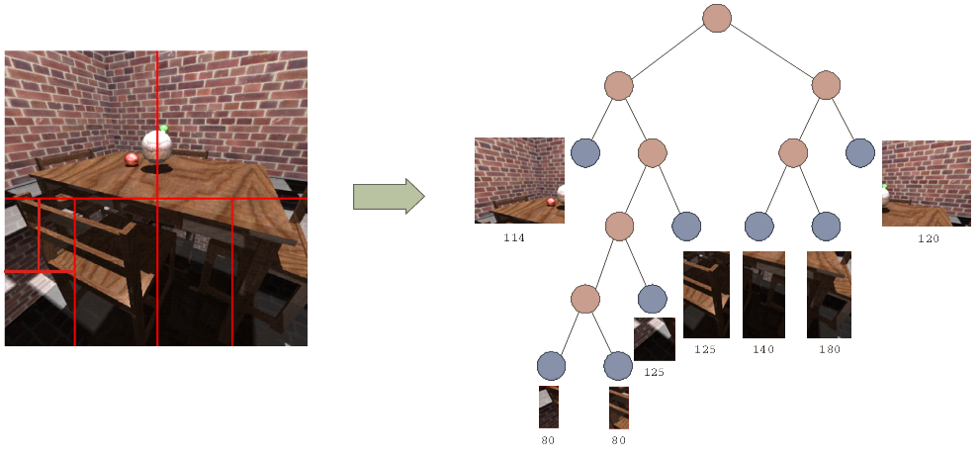
Exploiting PBT For PRT
Frame => Step
Pixel => item mesh
At each step/frame, the mesh is partitioned into balanced tiles (rectangular area of pixels) and assigned to workers

Slide 25
PBT demo video

Slide 26
2. Load Balancing based on Cost Evaluation
  Synergy Effects of Hybrid CPU-GPU Architectures for Interactive Parallel Ray Tracing
  GPU Cost Estimation for Load Balancing in Interactive Parallel Ray Tracing
  Biagio Cosenza, Ugo Erra, Carsten Dachsbacher
  (submitted to a journal)
Synergy Effects of Hybrid CPU-GPU architectures for Interactive Parallel Ray Tracing. Biagio Cosenza
Science and Supercomputing in Europe, Research Highlights 2009. HPCEuropa2 Technical Reports ISBN 978-88-86037-23-5, CINECA, 2009.
  Project HPC-Europa2
    Test ran at HLRS and VISUS (Universitaet Stuttgart),
    and ENEA Cresco Supercomputing

Slide 27
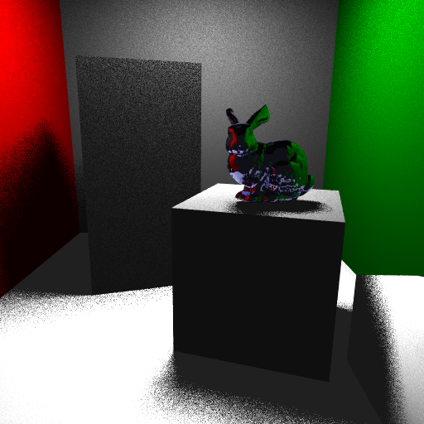
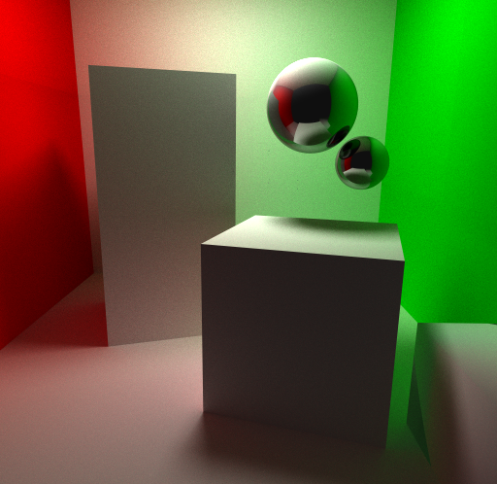
Ray Tracing Algorithms
Whitted Ray Tracing, almost
4M of primary rays at 1024x1024
MC path tracing, more than
1000M of primary rays at 1024x1024
Notes:
Ranging from a simple Whitted stle ray tracing to a Monte Carlo based.
Whitted is fast enough to rach interactive frame rate today.
MC techinques, instead, are slow – but photorealitic – phisically based

Slide 28
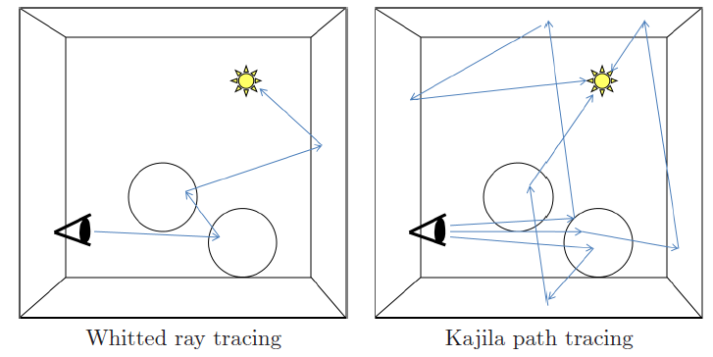
Ray Tracing Algorithms
Notes:
veloce

Slide 29
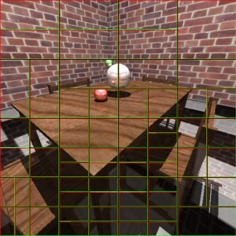
Parallel Ray Tracing
Image-space parallelization
Master node = visualization node

Slide 30
Parallel Ray Tracing
Our approach
  Vectorial parallelism
    Intel SSE instruction set
  Multithreaded parallelism
    pthread
  Distributed memory parallelism
    MPI
  Use GPU Rasterization in order to speed up rendering (improving load balancing)

Slide 31
Parallel Ray Tracing
Designed for cluster of workstations
  Availability of multi-core processors and SIMD instructions
Two task definition
  Tile
  Packet
Synchrounous rendering
Ray packets

Slide 32
Parallel Ray Tracing
Our approach to balance workload
Compute a per-pixel, image-based estimate of the rendering cost, called cost map
Use the cost map for subdivision and/or scheduling in order to balance the load between workers
A dynamic load balancing scheme improves balancing after the initial tile assignment
Notes:
Cost map = per-pixel cost evaluation of the rendering cost

Slide 33

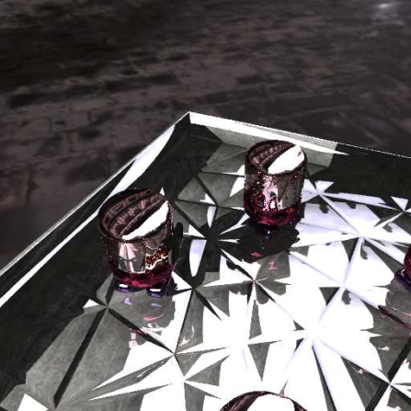
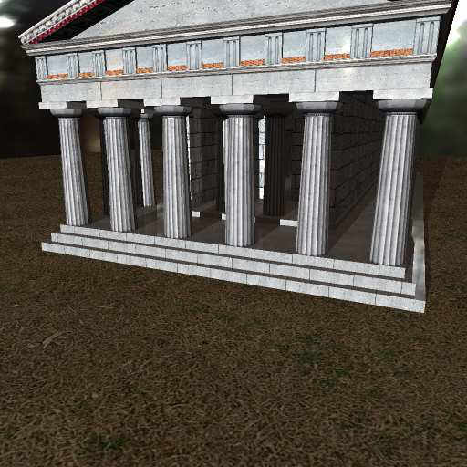
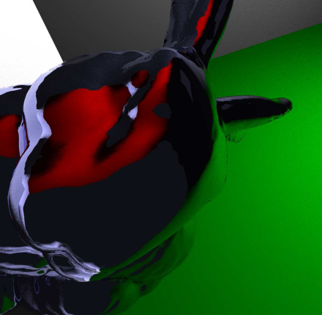
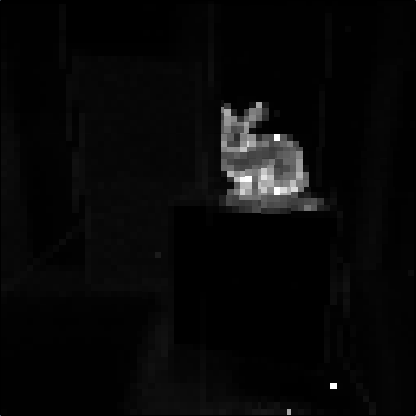
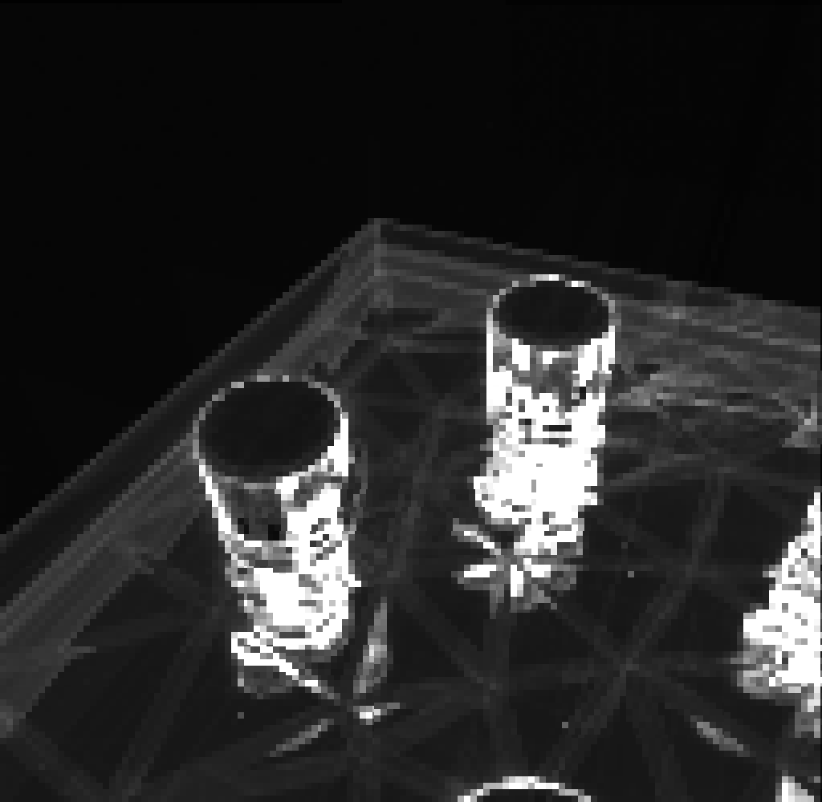
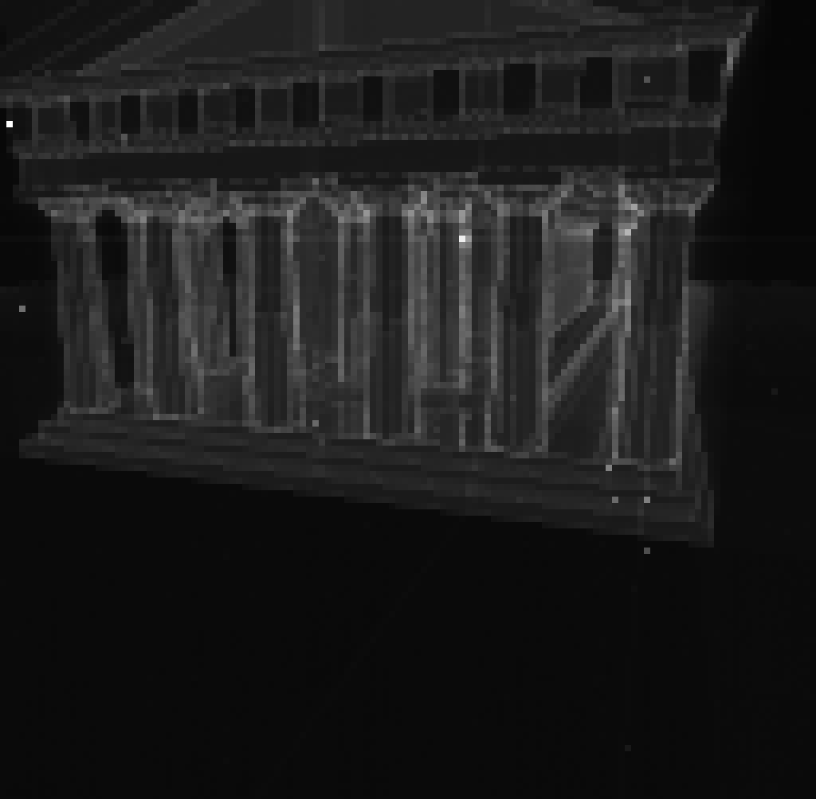
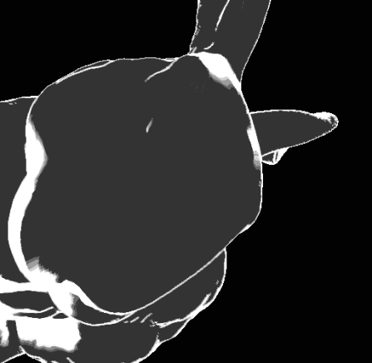
Generate a Cost Map

Slide 34

Generate a Cost Map
multiple
reflections
diffuse
specular
Notes:
A generic approach for evaluating the cost

Slide 35
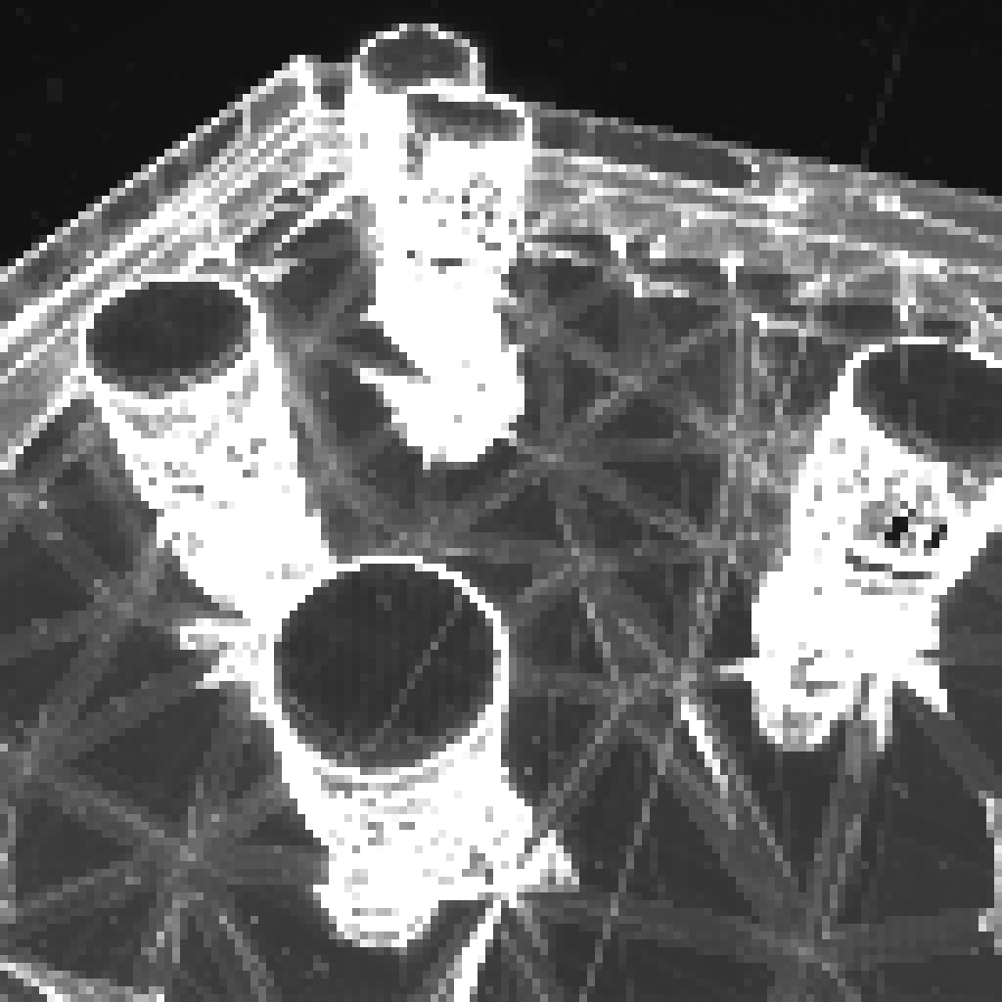
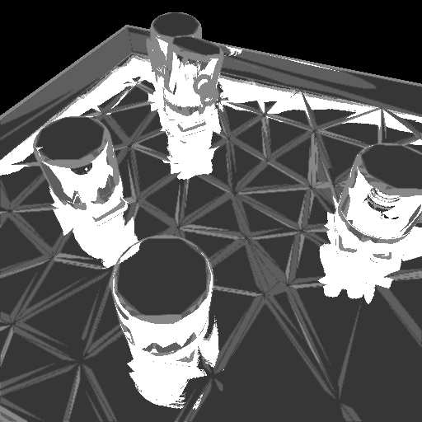
Cost Map Results
a comparison of the real cost (left) and
our GPU-based cost estimate (right)

Slide 36
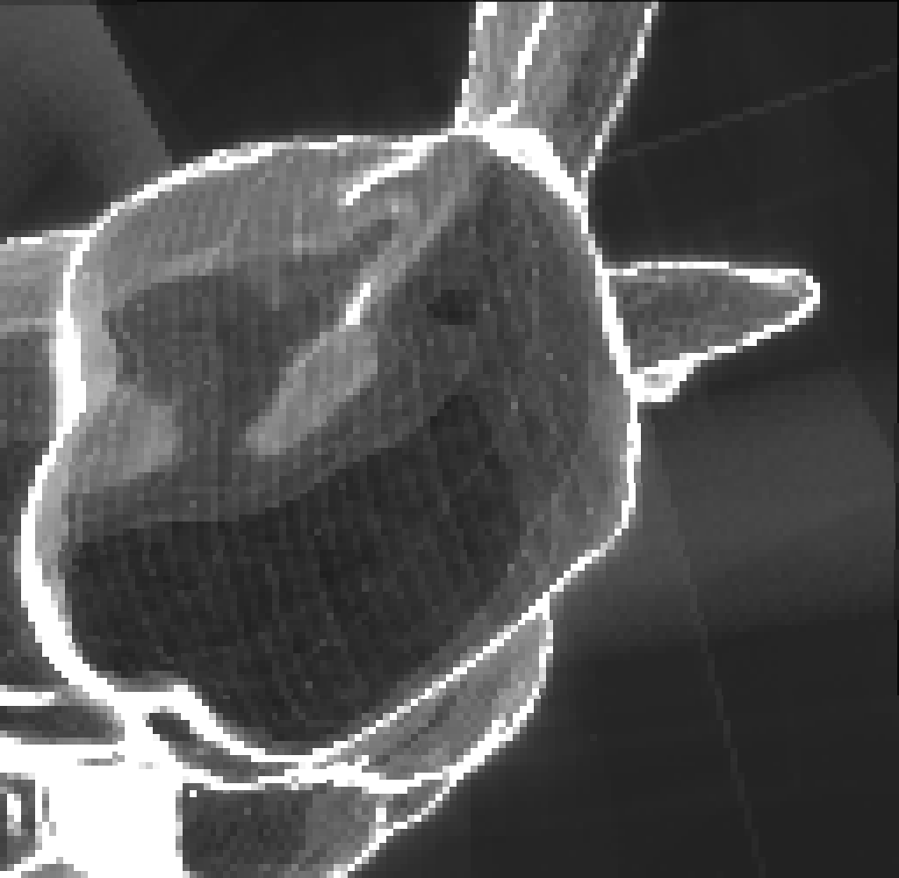

Cost Map Results
a comparison of the real cost (left) and
our GPU-based cost estimate (right)

Slide 37
Cost Map
Improves load balancing
Two approaches
  SAT Adaptive Tiling
  SAT Sorting

Slide 38
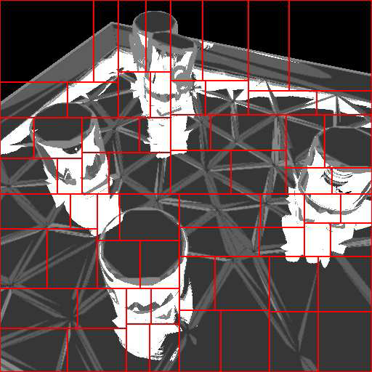
SAT Adaptive Tiling
Adaptive subdivision of the image into tiles of roughly equal cost

Slide 39
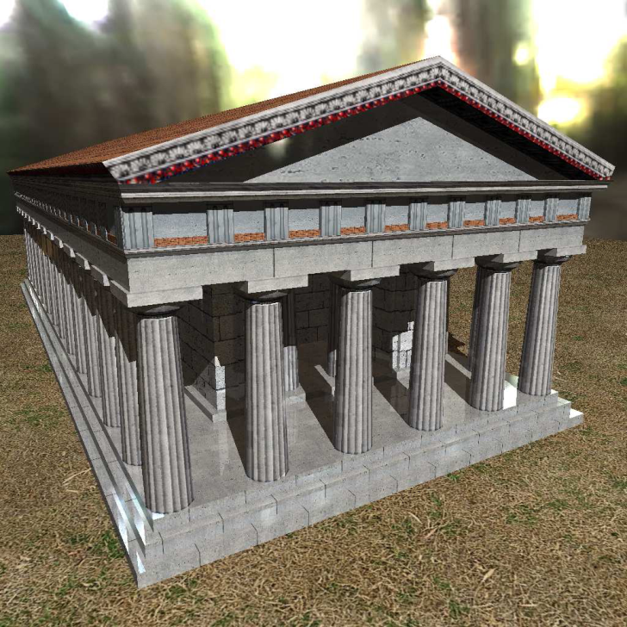
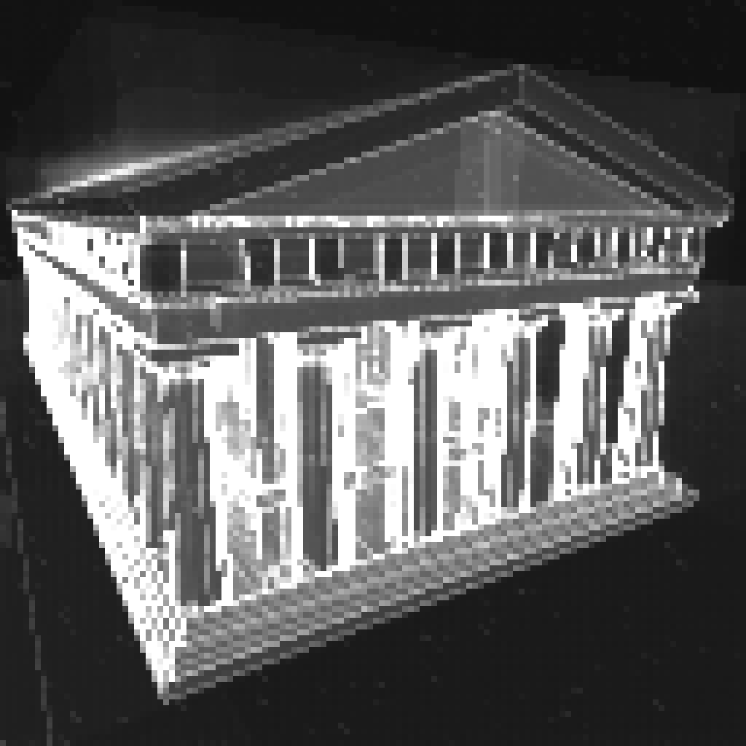
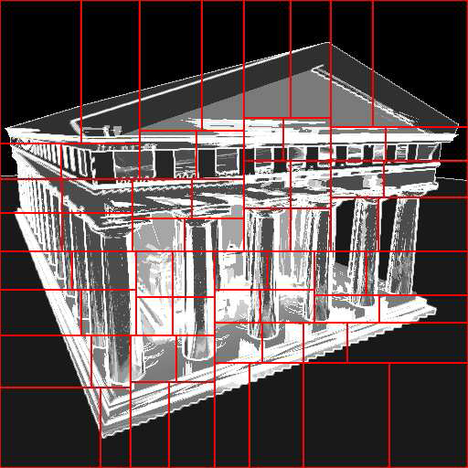
Cost Map and Adaptive Tiling

Slide 40
SAT Sorting
Use a regular subdivision
Sort tasks (=tiles) by estimate
Dynamic load balancing
  First schedule more expensive tasks
  Cheaper ones at the end
  Using work stealing, steals involve cheaper tasks
    Assure a fine grained load balancing
Use SAT (Summed Area Table) for fast cost evaluation of a tile
  SAT [Crow & Franklin, SIGGRAPH ‘84]
  SAT on the GPU [Hensley et al. 2005]

Slide 41
Work Stealing
master
tile assignment
workers
work stealing

Slide 42
Packetization
Two task definitions
  Tile for parallel architecture (cluster-node level)
  Packet for SIMD-based ray tracer (thread level)
Approach 1-to-1
  Problem to exploit best serial & parallel performances
Approach 1-to-many
  A tile is splitted in many packets
  Decouple the two layers using the best granularities for both
    16 tiles, each one subdivided in packets of 8x8 rays

Slide 43
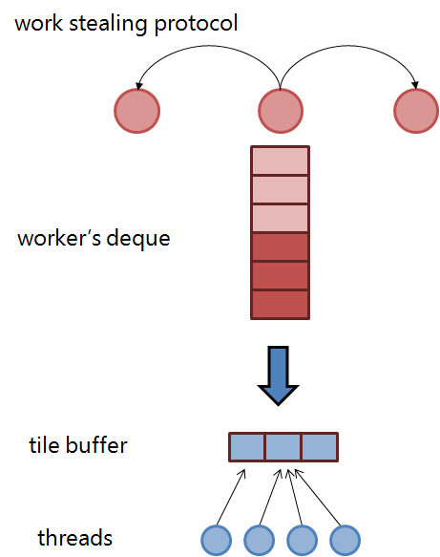

Slide 44
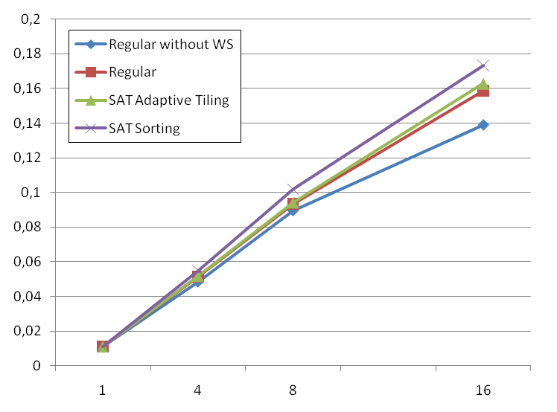
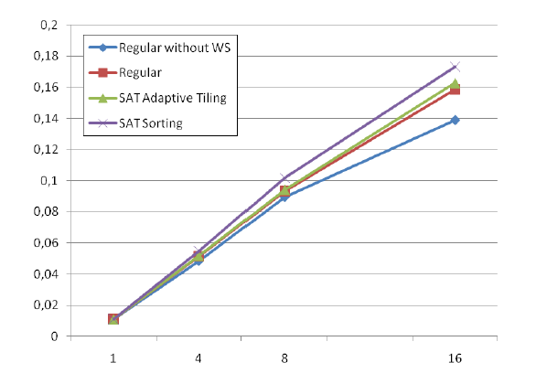
Results
fps
workers
Notes:
Performance with several test scenes (top-left)
Scalability on distr. memory (right and bottom-left)

Slide 45
Notes on Cost Map-based
Load Balancing
SAT Adaptive Tiling
  Needs a very accurate cost map estimate to have a gain
  “How much a tile is more expensive than another one?”
SAT Sorting
  It works also with a less accurate Cost Map
  “Which ones are the more expensive tiles?”
  Well fit with the work stealing algorithm
  Best performance

Slide 46
3. Agent-based Simulations
  Distributed Load Balancing for Parallel Agent-based Simulations
Distributed Load Balancing for Parallel Agent-based Simulations
Cosenza B., Cordasco G., De Chiara R., Scarano V.
PDP 2011 - The 19th Euromicro International Conference on Parallel, Distributed and Network-Based Computing
  Project has been granted by a ISCRA Cineca

Slide 47
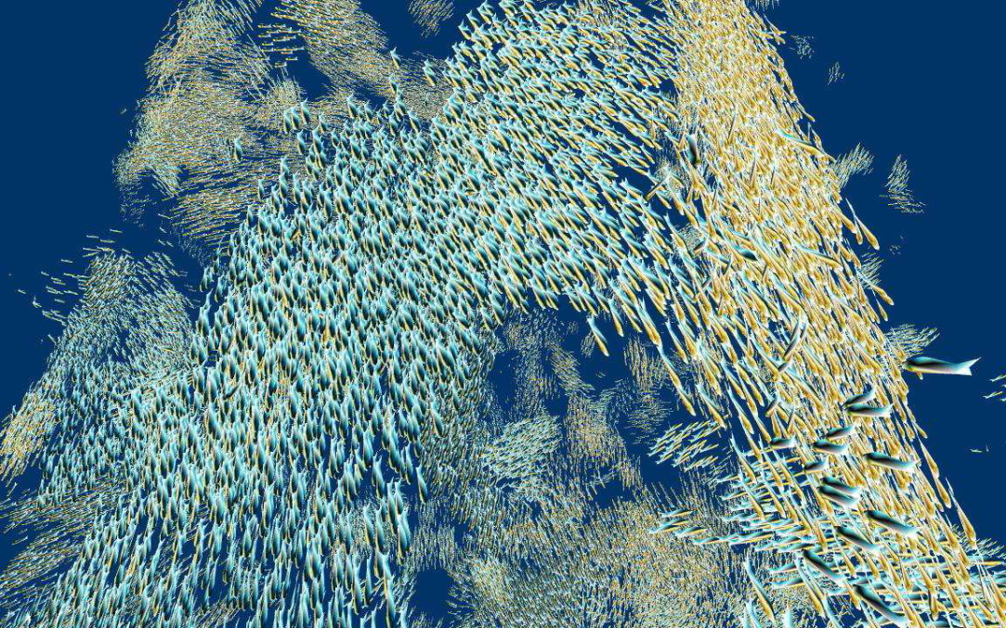
Agent-based Simulation
Autonomous agents (individual), whose movements are related to social interactions among group members
Examples
  flock of birds
  crowds
  fish school
  biological model

Slide 48
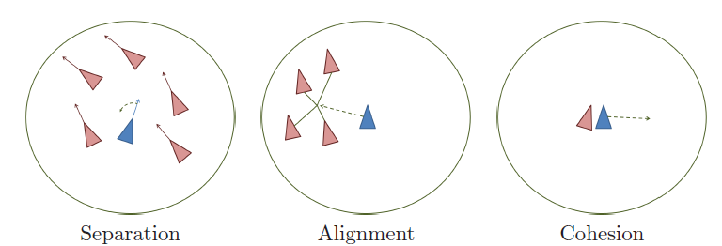
Reynolds Model
Alignment, steer towards the average heading of local flock-mates
Cohesion, steer to move toward the average position of local flock-mates
Separation, steer to avoid crowding local flock-mates
Alignment Cohesion Separation

Slide 49
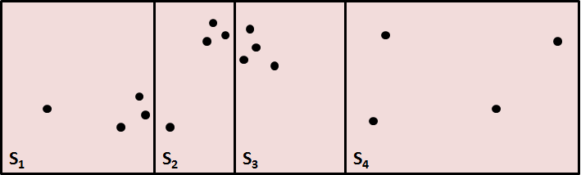
Parallelization of
Agent-based Simulation
Partitioning
  Distributed (not centralized)
  Even distribution (load balancing)

Slide 50
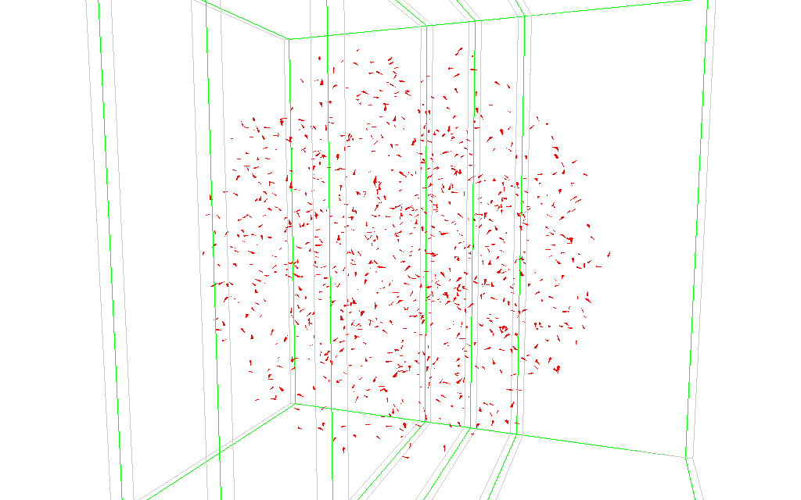
Parallelization of
Agent-based Simulation

Slide 51
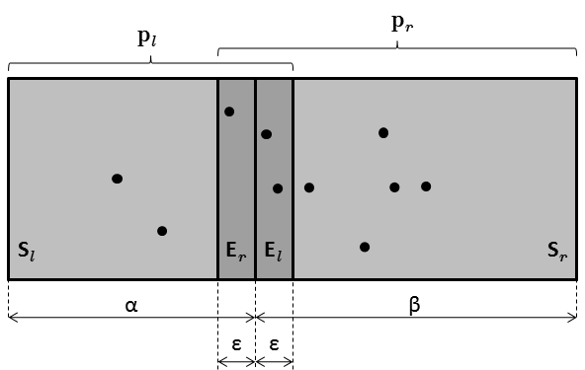
Two-procs schema

Slide 52
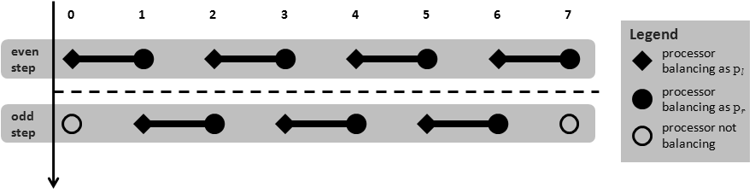
Multi-procs schema

Slide 53
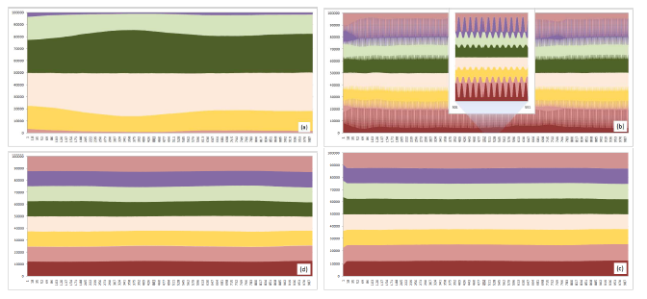
Load distribution
We proposed 4 different schemas
  Exploiting geometrical properties of the agents’ distribution

Slide 54
Agents Partitioning Demo Video

Slide 55
Conclusion
Distributed vs Centralized
  Fast vs Smart
  Distributed scales with the number of processors
Prediction/cost estimate-based approaches
  Accuracy vs Computation time
Work stealing
  Sorting
  Used on distributed system
Hybrid architectures may offer non-trivial design

Slide 56
Publications (1)
Experiences with Mesh-like computations using Prediction Binary Trees.
Gennaro Cordasco, Biagio Cosenza, Rosario De Chiara, Ugo Erra, and Vittorio Scarano.
Scalable Computing: Practice and Experience, Scientific International
Journal for Parallel and Distributed Computing (SCPE), 10(2):173-187, June 2009.
Load balancing in mesh-like computations using prediction binary trees.
Biagio Cosenza, Gennaro Cordasco, Rosario De Chiara, Ugo Erra, and Vittorio Scarano.
In ISPDC, pages 139-146, 2008.
A Survey on Exploiting Grids for Ray Tracing. Biagio Cosenza.
In Eurographics Italian Chapter Conference, pages 89-96, 2008.
On Estimating the Effectiveness of Temporal and Spatial Coherence in Parallel Ray Tracing.
Biagio Cosenza, Gennaro Cordasco, Rosario De Chiara, Ugo Erra, and Vittorio Scarano.
In Eurographics Italian Chapter Conference, pages 97104, 2008.
Load Balancing Techniques for Parallel Ray Tracing, 2008. Biagio Cosenza.
Poster at HPC-Europa++ TAM-Workshop 2008, presented on 15-17/12/08 at HLRS Supercomputing Center, Universit¨at Stuttgart.

Slide 57
Publications (2)
Synergy effects of hybrid CPU-GPU architectures for interactive parallel ray tracing. Biagio Cosenza.
Science and Supercomputing in Europe, Research Highlights 2009. HPCEuropa2
Technical Reports ISBN 978-88-86037-23-5, CINECA, 2009. ISBN 978-88-86037-23-5.
Evaluation of adaptive subdivision schemas for parallel ray tracing.
Biagio Cosenza.
HPC-Europa: Science and Supercomputing in Europe, Technical Reports
2008 ISBN 978-88-86037-22-8, 2008. ISBN 978-88-86037-22-8.
GPU Cost Estimation for Load Balancing in Parallel Ray Tracing.
Biagio Cosenza, Carsten Dachsbacher, and Ugo Erra.
(under review)
Distributed load balancing for parallel agent-based simulations.
Biagio Cosenza, Gennaro Cordasco, Rosario De Chiara, and Vittorio Scarano.
In PDP2011 - 19th Euromicro International Conference on Parallel, Distributed and Network-Based Computing, 2011.

Slide 58
Thanks for your attention
Question?

Slide 59
Updating PBT
The algorithm PBT-update performs a sequence of simultaneous split-merge operation, that consist in splitting a tile whose estimated load is “high” and merge two sibling tiles whose estimated load is “small”
176
Split
88
88
Merge
105
45
60

Slide 60
Updating PBT
At the end of each phase, the master receives (with the tile output) also the time spent on it
Then, the PBT is updated for the next phase
The variance of tile times is used to evaluate the current load balancing
Formally the variance is defined by
where is the estimated average computational time

Slide 61
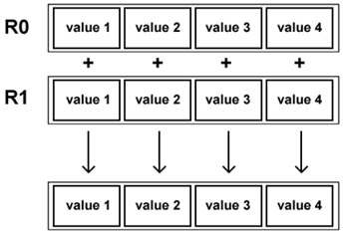
Vectorial parallelisation
SIMD instruction set
  Intel SSE
Example
  128 bit vector = 4 floats
  4x ‘potential’ speedup
Notes:
SIMD instruction offers a change to speed-up performance.
SIMD/vectorial programming is hard.
In order to reach an optimal speed-up, often we need to rethink the problem.

Slide 62
Ray packets
A list of rays
  Some may be inactive
  Some spatial/directional coherence implied
Useful both for SIMD and non-SIMD
  Exploit memory coherence
  Exploit 4*-wide SIMD instruction
Used in CPU implementations [Wald 2004]
  GPU implementations don’t use it* (SIMT)

Slide 63
Updating PBT
The algorithm PBT-update performs a sequence of simultaneous split-merge operation, that consist in splitting a tile whose estimated load is “high” and merge two sibling tiles whose estimated load is “small”
176
Split
88
88
Merge
105
45
60

Slide 64
Updating PBT
At the end of each phase, the master receives (with the tile output) also the time spent on it
Then, the PBT is updated for the next phase
The variance of tile times is used to evaluate the current load balancing
Formally the variance is defined by
where is the estimated average computational time

Slide 65
Vectorial parallelisation
SIMD instruction set
  Intel SSE
Example
  128 bit vector = 4 floats
  4x ‘potential’ speedup
Notes:
SIMD instruction offers a change to speed-up performance.
SIMD/vectorial programming is hard.
In order to reach an optimal speed-up, often we need to rethink the problem.

Slide 66
Ray packets
A list of rays
  Some may be inactive
  Some spatial/directional coherence implied
Useful both for SIMD and non-SIMD
  Exploit memory coherence
  Exploit 4*-wide SIMD instruction
Used in CPU implementations [Wald 2004]
  GPU implementations don’t use it* (SIMT)

Slide 67
Cost Map Generation a GPU technique
Add a basic shader cost for the hit surface
If reflective, compute sampling
  Compute the sampling pattern
  For each sample, do a visibility check by using the reflection cone
    If visible, add the cost of the reflected surface
    If the hit surfaces is reflective, add a penalty cost
    If the reflection cone of the hit surface hit the first one, add a penalty cost
Use a edge detection filter for raise the cost of “borders”
  In ray tracing, packets falling there need to be split and have a higher cost

Slide 68
Dynamic Load Balancing
Work Stealing
  Distributed dynamic load balancing
Tile Deque
In-frame steals
Stealing protocol optimizations

Slide 69
Other Optimizations
Latency hiding
  Task prefetching and asynchronous data send & receive
Optimized GPU techniques
  Cost Map and SAT in a compressed format
  SAT computed in the GPU
Asynchronous GPU prediction

