Slide 1
Dipartimento di Medicina, Chirurgia e Odontoiatria “SCUOLA MEDICA SALERNITANA” Corso di Dottorato Medicina Traslazione dello Sviluppo e dell’Invecchiamento Attivo Ciclo XXXIII Codice DOT1328517 Untargeted metabolomics as a diagnostic tool in NAFLD: discrimination of steatosis, steatohepatitis and cirrhosis
Relatore Candidato
Char.mo Prof. Dott. Valerio Rosato
Marcello Persico Matr. 8800900026

Slide 2
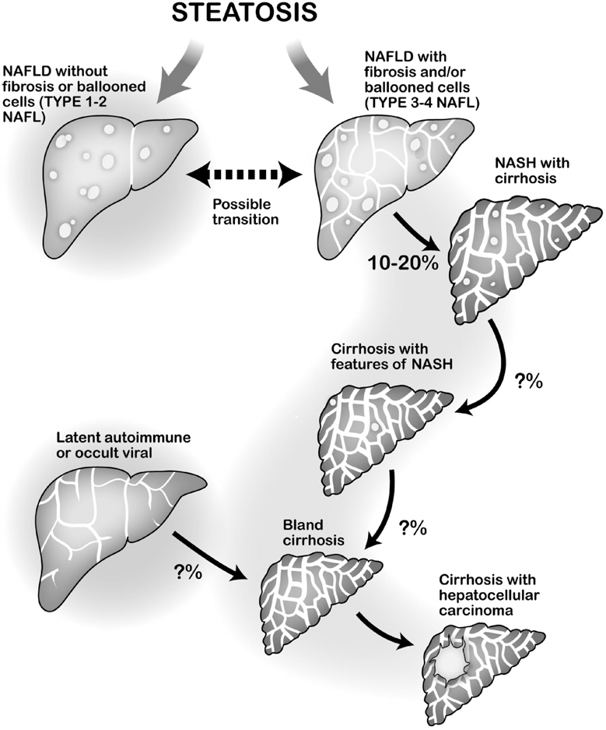
Background
Non-Alcoholic fatty liver disease (NAFLD) is a spectrum of metabolic abnormalities that ranging form simple steatosis (NAFL) and a “progressive” form of hepatitis (NASH) that may lead to Cirrhosis.
Due to the changes in dietary habits and increased sedentary lifestyle, NAFLD is becoming in the last decades one of the most frequent liver disease.
Actually it represents the 3th cause of liver transplantation in USA.
The “next” challenge for hepatologists in NAFLD represents the recognition of the disease, its progression, and its therapeutic options

Slide 3
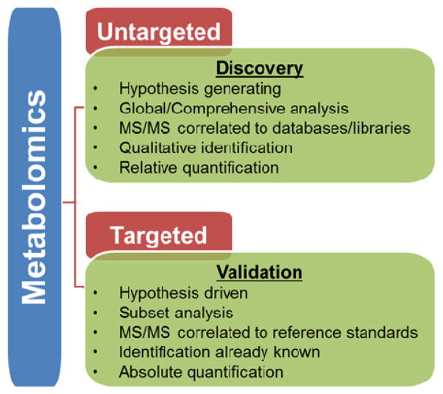
Background
Metabolomics technique offers a non-invasive, holistic approach to the insights of diseases.
It has the advantage to evaluate the “phenotype” of a disease, in respect to genes, transcripts and proteins, which very likely undergo to epigenetic, transcriptional and pre- and post- translational modifications.

Slide 4
Background
Untargeted Metabolic use technique as Gas-Cromatography (GC) – Mass-Spectometry (MS) to identify a large list of small molecules ( <1,5 kDalton).
Small molecules are composed by amino-acids, sugars, lipids or other intermediated metabolites.
GC-MS is able to isolate 300 signals, corresponding to 250 molecules.

Slide 5
Small molecules can be mapped through ensemble machine learning ( EML) model, as PLS-DA, to networks and pathways, allowing to identify the metabolic processes.
In the field of NAFLD few studies, on a small number of patients, have recently sketched a partial metabolomics profile of such disease.

Slide 6
Obiettivo
Study type
Multicenter (University of Salerno – University of Campania ”Luigi Vanvitelli” – University of L’Aquila), no-profit, non interventional cross-sectional observational study.
Endpoints
Primary: To differentiate serum metabolomics profiles of NAFL, NASH, NAFLD-cirrhotic patients in order to find a diagnostic, prognostic and eventually therapeutic tool
Secondary: to evaluate serum metabolomics profile of an Italian cohort of NAFLD patients

Slide 7
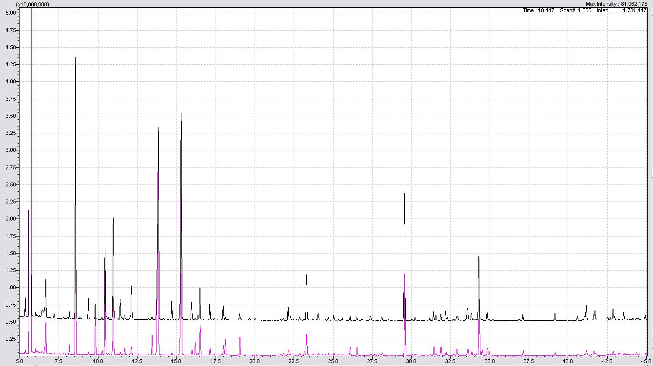
Methods
Inclusion criteria:
Biopsy proven* NAFLD pts of every stage, also cirrhosis (in the last 12 months)
Exclusion criteria:
Any other cause of liver disease (viral, autoimmune, metabolic, unsafe alcohol. etc)
Age and sex matched control group
Metabolomic Extraction: Metabo-prep GC
Metabolomic Analysis: GC-MS system (GC-2010 Plus Gas Cromatographer coupled to a 2010 Plus single quadrupole mass spectrometer) – based in Salerno University spin-off Society Theoreo.
* Except for clinical cirrhosis pts

Slide 8
Enrolled subjects
Enrolled Subjects
N = 307
First Enrollement
(Training Set)
N = 213
Second Enrollement
(Validation Set)
N = 94
Controls
N = 69
NAFLD
N = 144
Controls
N = 44
NAFLD
N = 50
NAFL
N = 78
NASH
N = 23
Cirrhosis
N = 43
NAFL
N = 34
NASH
N = 10
NASH-Cirrhosis
N = 6
Cirrhosis HCV
N = 8
NASH-Cirrhosis
N = 15
Cirrhosis Cripto
N = 20
CONTROLS N=113
Recruited from the blood donors bank of the Transfusion Center of the University of Salerno
(subjects without any evidence of Metabolic Syndrome, diabetes and/or NAFLD)

Slide 9
Demographical data
Demographical and laboratory characteristics of the study population by liver Histology presentation.
 | Overall | NAFL | p NAFL vs NASH | NASH | p NASH vs NASH-Cirrhosis | NASH-Cirrhosis
Total Number | 194 | 112 | - | 33 | - | 21
Age (years±SD) | 60.85±16.0 | 57.7±17.8 | 0.95 | 57.5±14.7 | 0.01 | 65.8±10.1
Male Sex (%) | 111 (57.2%) | 66 (58.9%) | 0.67 | 18 (54.5%) | 0.66 | 11 (52.4%)
BMI (Kg/m²) | 29.6±4.3 | 29.6±4.0 | 0.17 | 30.8±4.5 | 0.8 | 31.1±5.1
AST (U/L) | 37.12±28.8 | 33.0±32.7 | 0.32 | 43.5±56.1 | 0.55 | 40.6±19.8
ALT (U/L) | 44.9±45.86 | 43.5±56.1 | 0.25 | 53.6±39.9 | 0.62 | 49.2±29.7
Diabetes (%) | 50 (25.8%) | 27 (24.1%) | 0.008 | 16 (48.8%) | 0.148 | 12 (57.1%)
Glycaemia | 111.5±38.2 | 108.0±39.9 | 0.56 | 111.4±24.5 | 0.44 | 118.0±36.4
Serum Insulin | 19.8±15.6 | 15.3±12.3 | 0.005 | 28.6±18.8 | 0.85 | 30.4±20.1
HOMA | 5.3±5.1 | 3.9±3.4 | 0.001 | 8.0±7.3 | 0.84 | 7.3±6.7
Hypertension (%) | 75 (38.6%) | 58 (51.8%) | 0.011 | 25 (75.8%) | 0.964 | 21 (58.3%)
HDL Cholesterol(mg/dL) | 44.7±12.9 | 45.1±12.7 | 0.88 | 45.4±11.7 | 0.39 | 45.4±11.7
TotalCholesterol(mg/dL) | 177.8±42.9 | 183.2±39.9 | 0.16 | 194.5±40.7 | 0.015 | 166.4±39.3
Triglycerides (mg/dL) | 140.2±72.4 | 144.5±75.3 | 0.20 | 163.1±66.7 | 0.22 | 137.3±79.4
Metabolic Syndrome(%) | 103 (53.1%) | 62 (55.3%) | 0.00001 | 29 (87.9%) | 0.81 | 17 (80.9%)
GGT (U/L) | 71.2±81.6 | 52.1±72.1 | 0.10 | 77.5.1±82.4 | 0.33 | 103.2±108.3
Ferritin (μg/L) | 178.7±208.2 | 221.9±214.0 | 0.53 | 185.0±225.5 | 0.57 | 137.3±235.6
Liver Stiffness | - | 5.73±2.8 | 0.006 | 16.1±15.4 | - | -

Slide 10
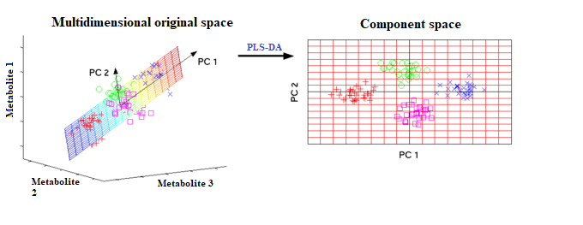
Partial Least Square-Discriminant Analysis
(PLS-DA) Models Training
1. The concentration of the detected metabolites are firstly projected in a multidimensional space, then the observation point is selected, which allows to obtain the maximum separation between the classes and the minimum within the classes
2. The most influential metabolites in generating the classification (VIP - Variable Importance of Projection) are selected, and these are used to create metabolic maps

Slide 11
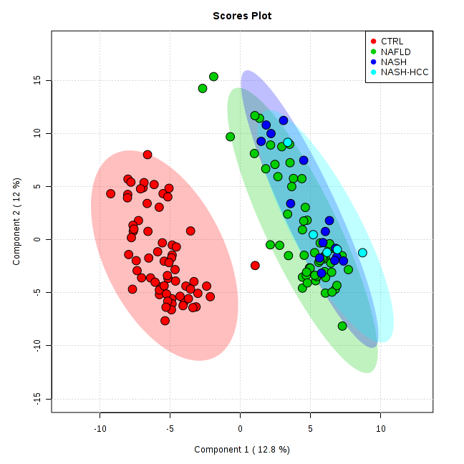
PLS-DA Model Plots on training set
Over 250 signals were detected in a single specimen and a total of 228 endogenous metabolites were detected consistenlty.
A good separation between the classes of NAFLD was obtained.
NAFLD n:144
CTRLs n:69
Masarone M, Troisi J, Persico M Metabolomic 2021

Slide 12
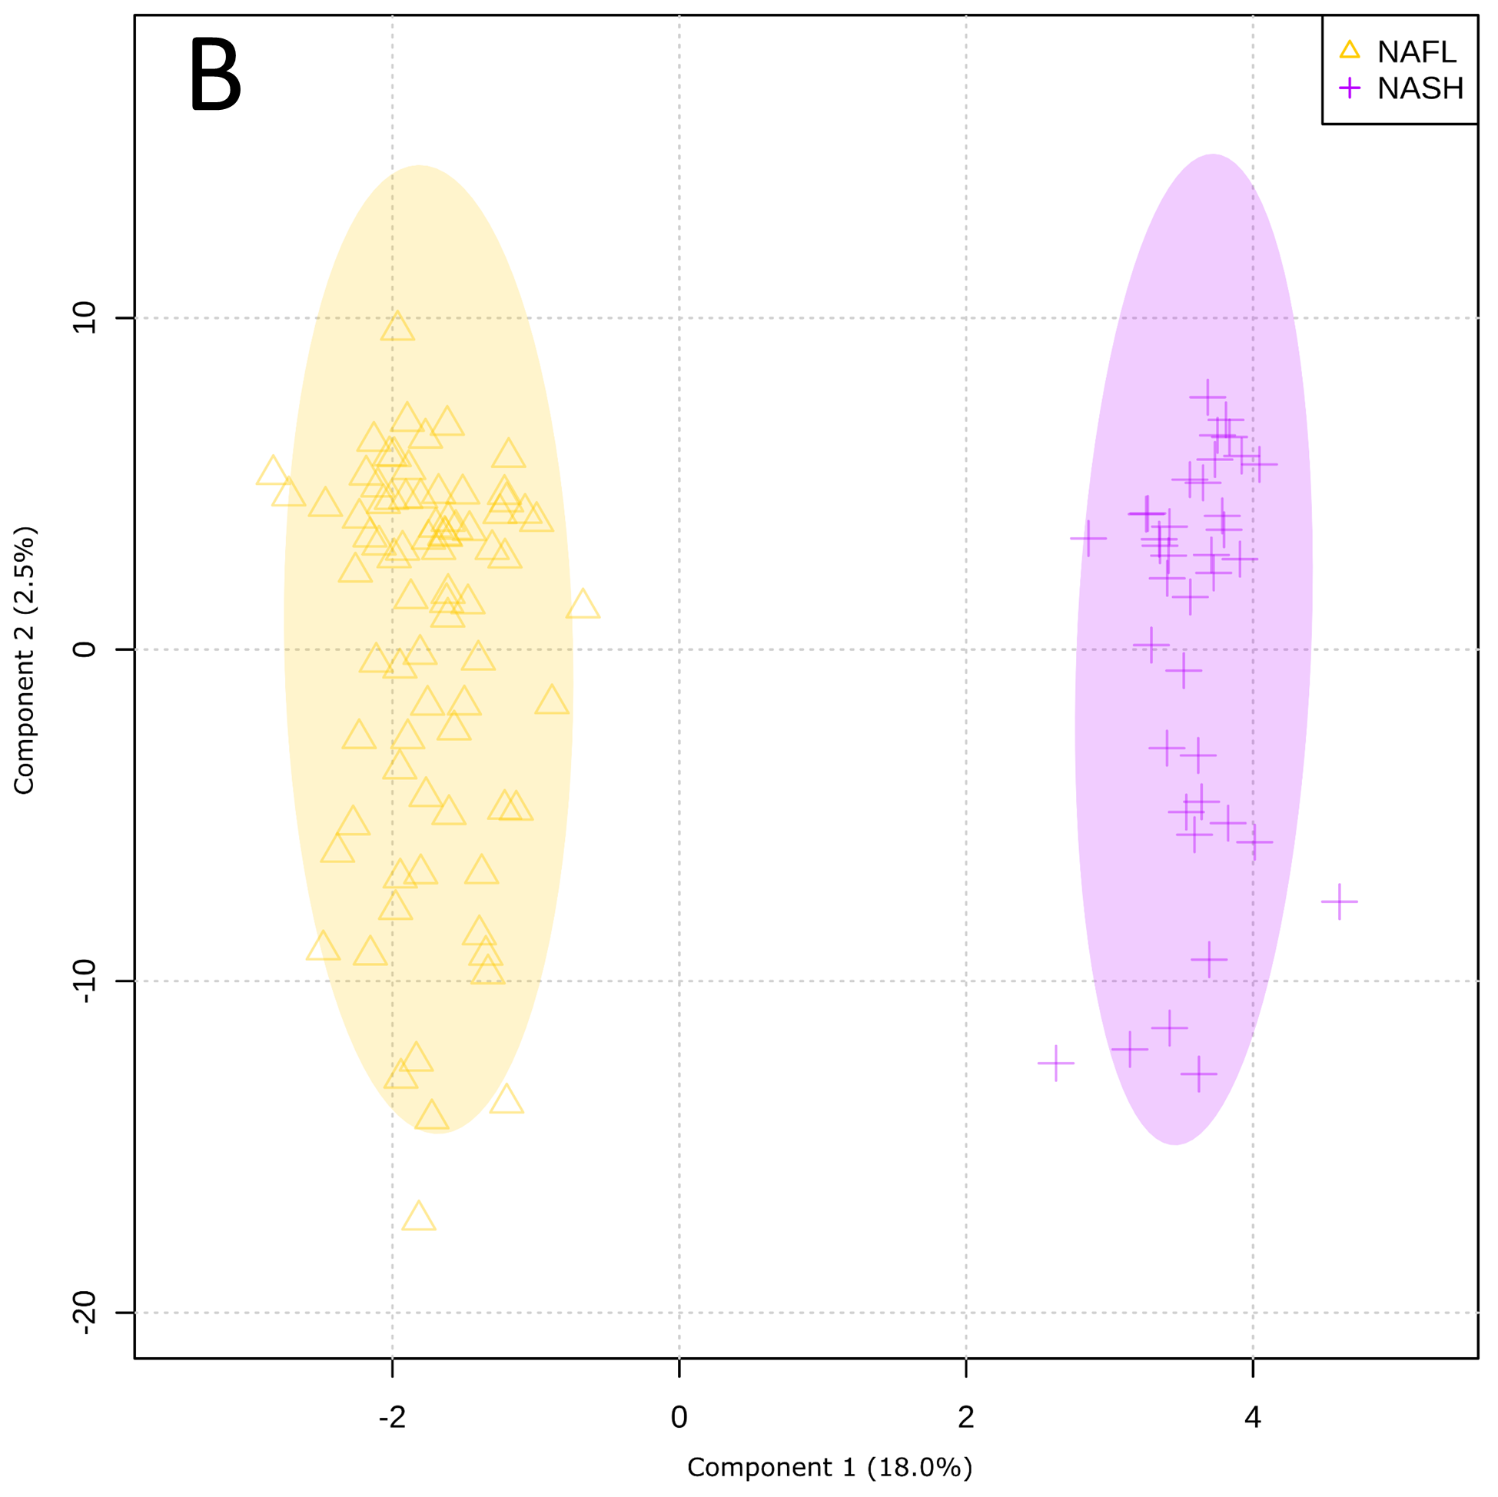
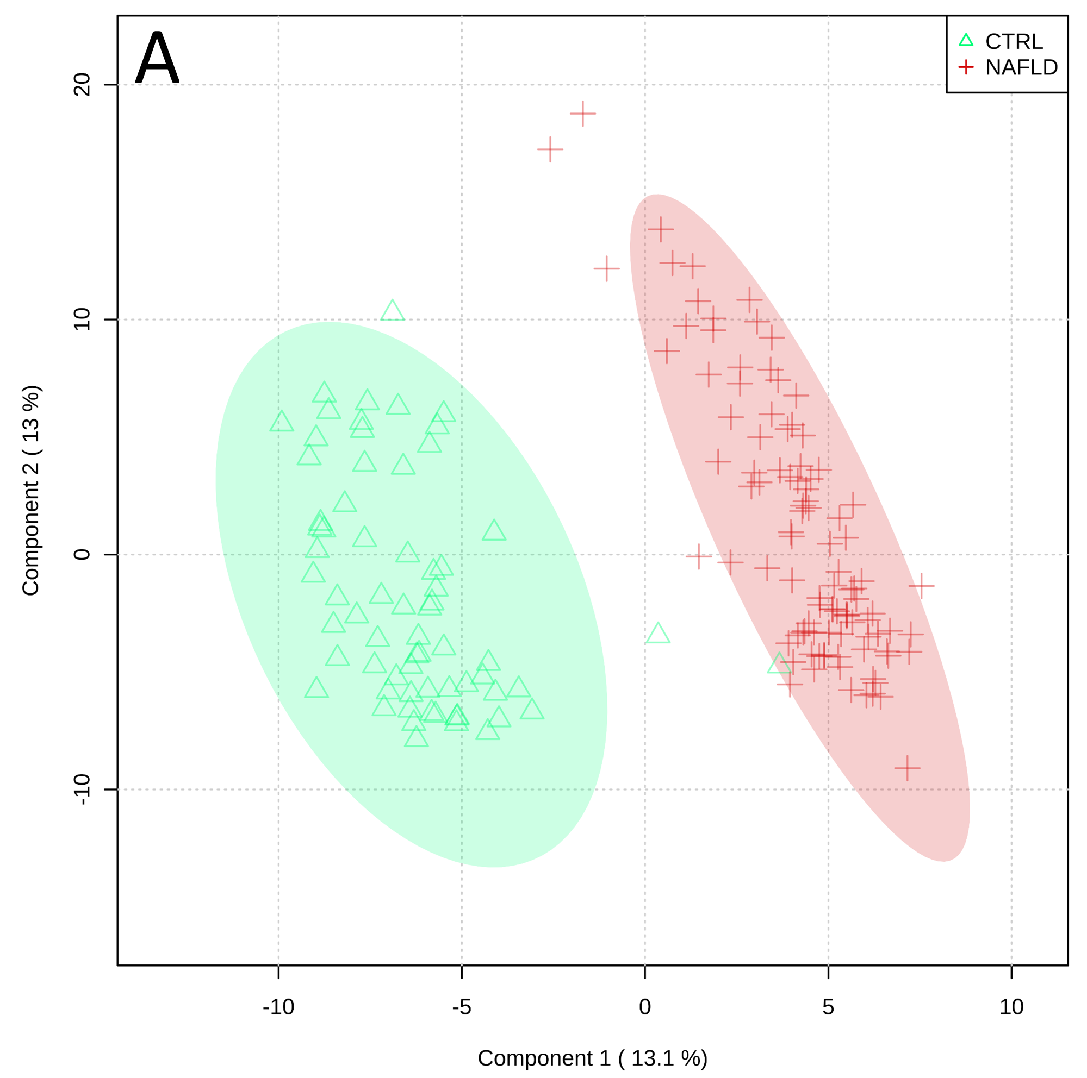
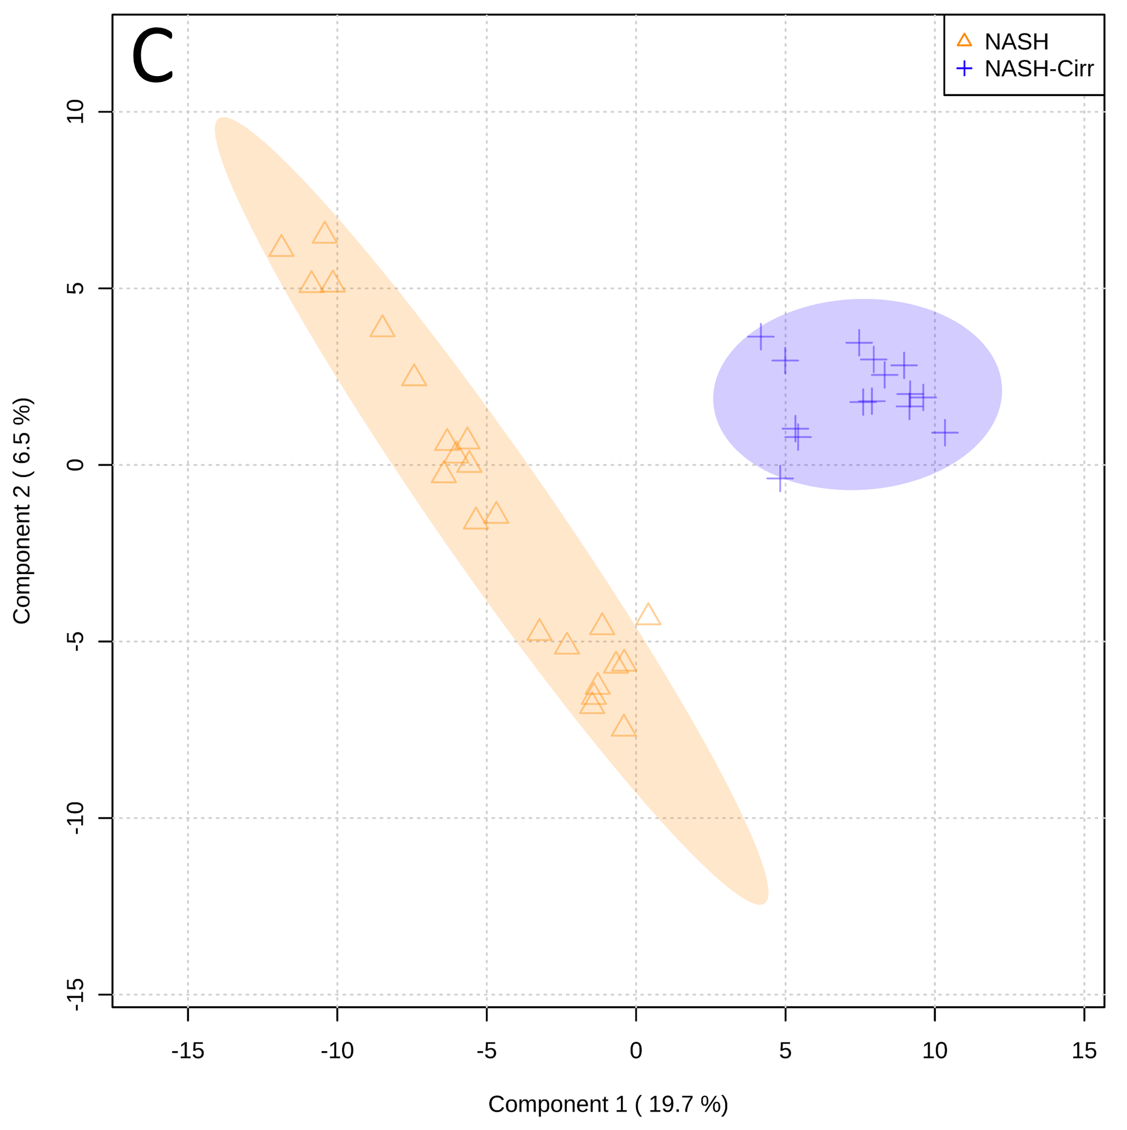
PLS-DA Score Plots on
all study population
NAFL n: 112
NASH n: 33
NAFLD n: 194
CTRLs n: 113
NASH
Cirrhosis n: 21
PLS-DA Score Plots clearly differentiated the study population between the classes of NAFLD.
NASH n: 33

Slide 13
PLS-DA Score Plots on cirrhotic pts
PLS-DA Score Plots clearly differentiated cirrhotic patients in according to their cirrhosis etiology.
HCV n: 8
NASH n:15
Cripto n: 20

Slide 14
VIP Metabolites
15 metabolites with a VIP score higher than 1,5 identified by PLS-DA model

Slide 15
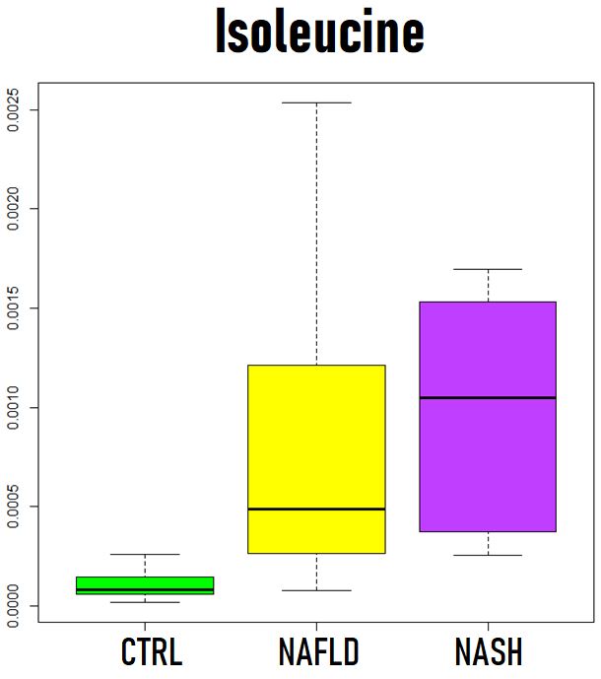
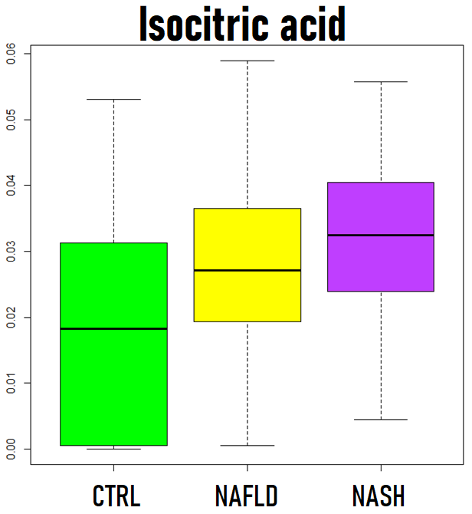
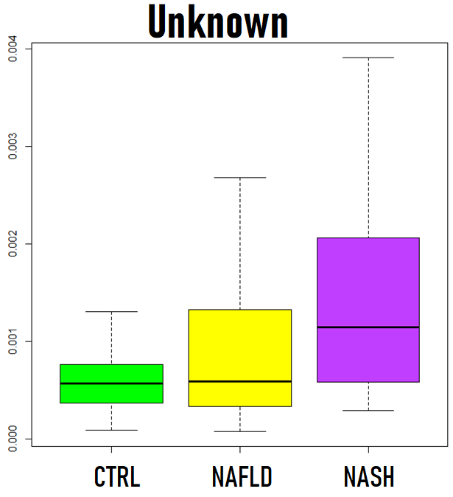
VIP metabolites decreased in controls and increased in NAFLD progression
During the evolution of the inflammation/fibrosis process, intermediate metabolites of the tricarboxylic acid cycle, branched chain amino acids and fatty acids are accumulated in the sera of affected individuals. These results were recently confirmed also on a murine model of fibrosis induced by CCl4*. BCAA were also correlated with insulin resistance and cardiometabolic risk†.
*Chang H et al, Sci Rep. 2017 Sep 12;7(1):11433.
†Gaggini et al. Hepatology. 2018 Jan;67(1):145-158.

Slide 16
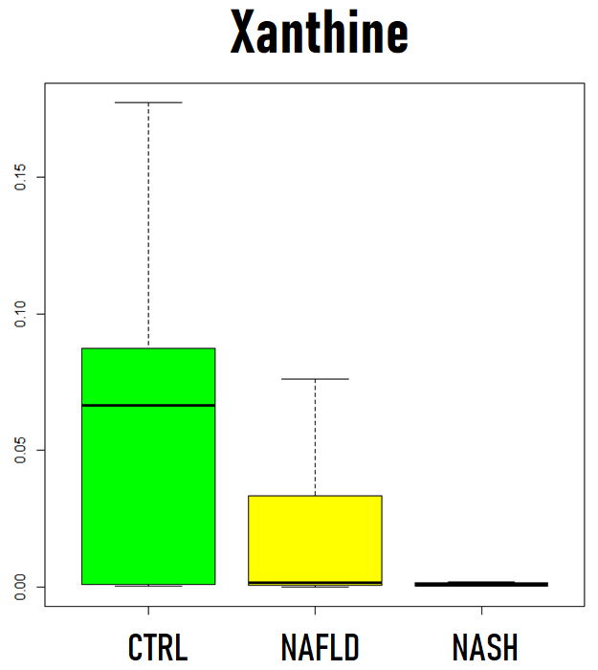
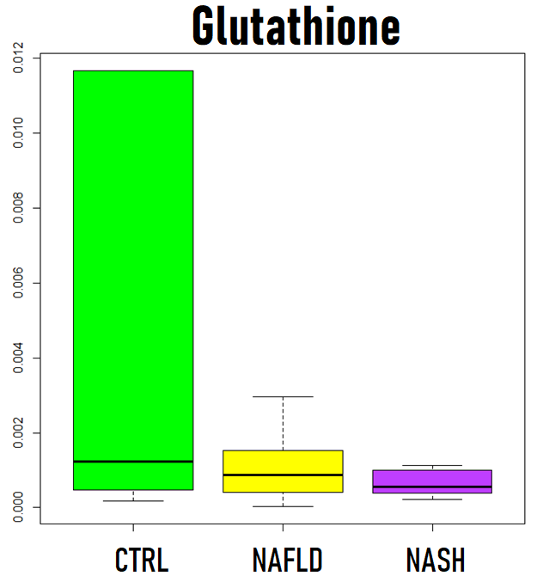
VIP metabolites increased in controls
The reduction of xanthine levels may be linked to the close relationship, between the evolution of NAFLD and hyperuricemia
The increase in oxidative stress in the progression of NAFLD is demonstrated by the reduction of serum Glutathione levels. This evidence has been repeatedly reported in the literature
Chang H et al, Sci Rep. 2017 Sep 12;7(1):11433
Xu C et al, J Hepatol. 2015 Jun;62(6):1412-9
Liu W et al. Curr Drug Targets. 2015;16(12):1301-14.
Gaggini et al. Hepatology. 2018 Jan;67(1):145-158

Slide 17
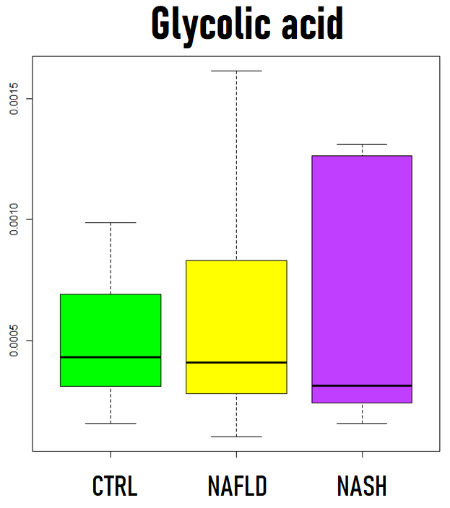
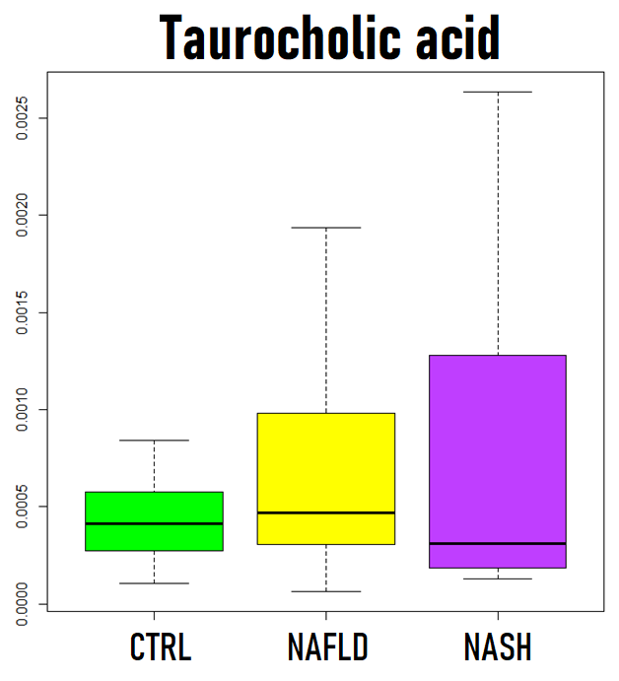
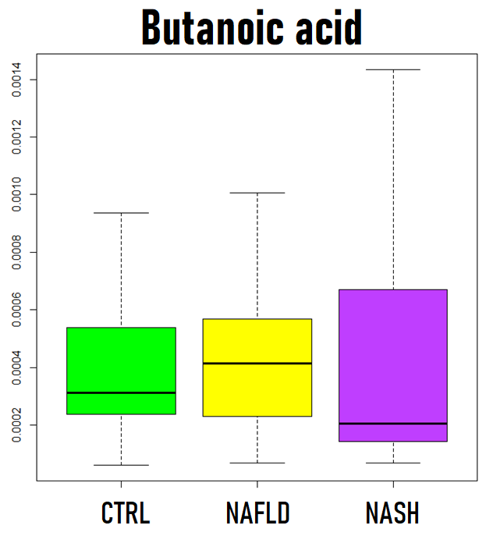
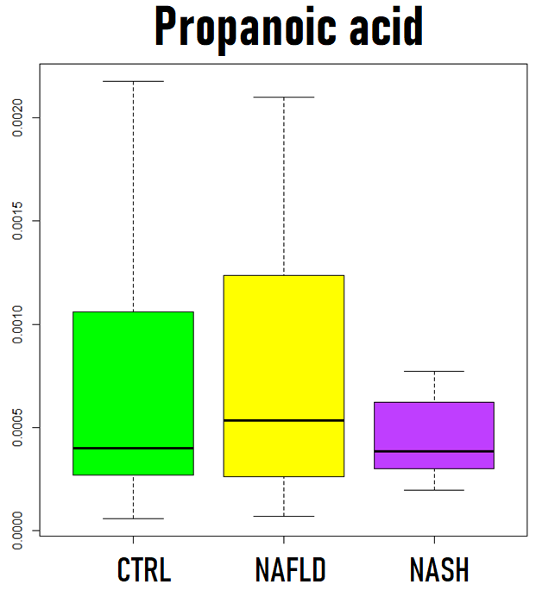
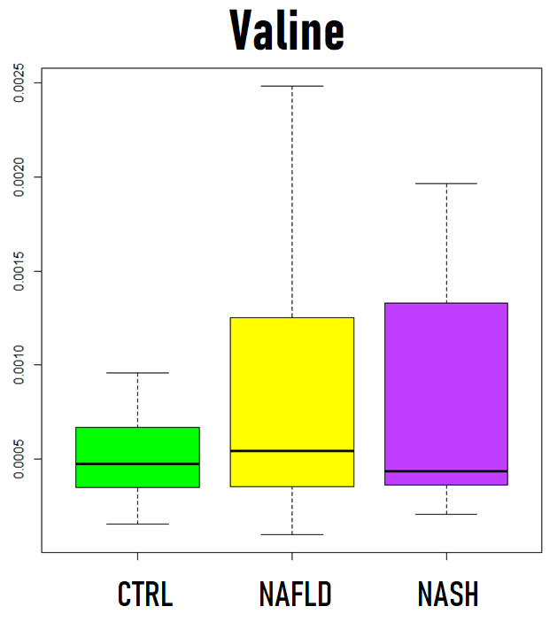
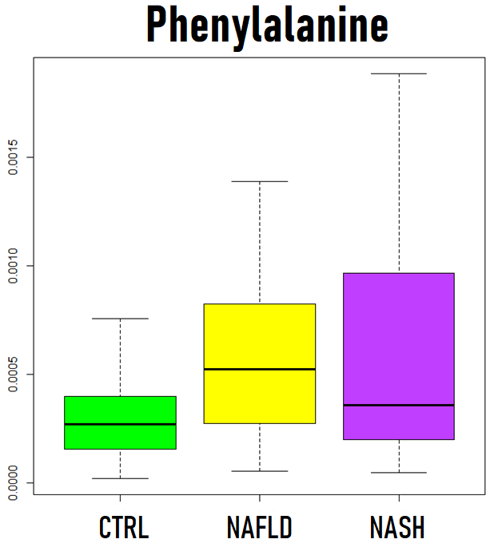
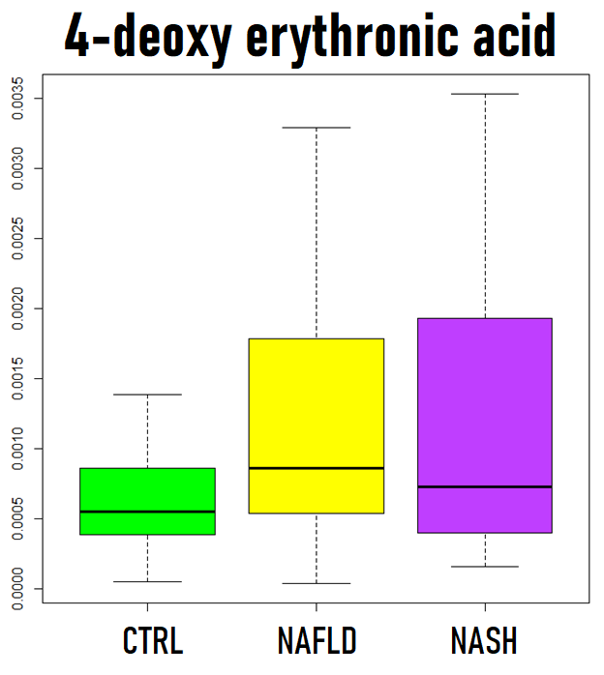
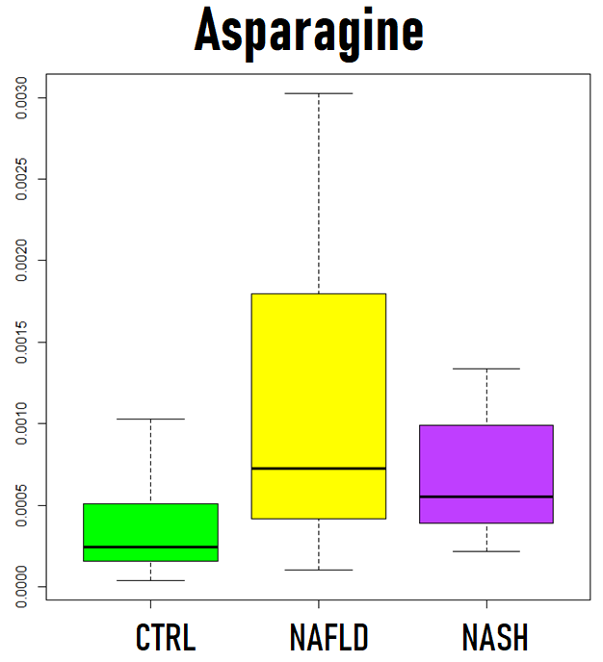
Bile acids biosynthesis intermediates
Short-chain Fatty Acids – SCFA – Diet/Gut Microbiota
Essential BCAA - Diet/Gut Microbiota
Derived from Threonine
Essential AA - Diet/Gut Microbiota
Non-Essential AA - Urea Cycle
Essential AA – Derived from diet
Other VIP metabolites show more complex trends and need further analyses on larger numbers.
SCFA and Essential AA enlighten the relationship of the evolution of NAFLD with the intestinal microbiota, the gut-liver axis, intestinal permeability and diet.

Slide 18
Heat-map representation of the genetic algorithm selected metabolites
through the NAFLD evolution stages
Concentrations of selected metabolites
CTRL NAFL NASH Cirrhosis
constantly decreased from CTRL vs disease progression
Fatty acids related metabolites
follow a more complex route (decreased in early stage and increased in advanced ones)
Amino acid and GUT microbiota related metabolites
constantly increased from CTRL vs disease progression
Sugars

Slide 19
NAFLD METABOLOMIC SCORE
We built 3 different Essemble Machine Learning models, one able to discriminate healthy subject from NAFLD (model 1), simple steatosis (NAFL) from patients with steatohepatitis or cirrhosis (model 2), NASH patients NASH-cirrhosis (model 3).
Blind analysis on the Validation Set (subjects of the second enrolment) of NAFLD METABOLOMIC SCORE ( NAFLD – EML – Score) for the identification of NAFLD evolution stage.
Classification models performance. Values are reported as result ± standard error. Cumulative accuracies were reported in brackets.
 | Sensitivity (%) | Specificity (%) | PLR | NLR | PPV (%) | NPV (%) | Accuracy (%)
Model 1 (Ctrl Vs NAFLD) | 96.0±2.8 | 97.7±2.2 | 42.24 | 0.041 | 98.0±2.0 | 95.6±3.1 | 96.8±2.1
Model 2 (NAFL Vs NASH & NASH-Cirrhosis) | 94.1±4.0 | 93.8.3±6.1 | 15.06 | 0.063 | 97.0±3.0 | 94.0±4.2 | 94.0±4.2 (91.0±2.1)
Model 3 (NASH Vs NASH-Cirrhosis) | 80.0±12.6 | 83.3±15.2 | 4.80 | 0.240 | 88.9±10.5 | 71.4±17.1 | 81.3±12.2 (73.9±9.7)
PLR: positive likelihood ratio; NLR: negative likelihood ratio; PPV: positive prognostic value; NPV: negative prognostic value.

Slide 20
Metabolic system map
Palmitic Acid
Glutathione
Asparagine
Valine
Stearic Acid
Taurocholate
Butyrate
L-Phenilalanine
Glycocholate
Xantine
Isocitrate
“VIP” COMPOUNDS

Slide 21
Conclusions
The serum metabolomic profile of patients with simple steatosis, NASH, cirrhosis is different
The untarget metabolomic can represent an appropriate tool for the diagnosis and the assessment of different form of NAFLD
Preliminary analysis of these differences confirmed a role of BCAA, TCA, biliary acids and xanthine oxidase deregulation, and an increase in oxidative stress as mechanisms involved in the evolution of the inflammatory process
Further evidence confirms the involvement of the diet and Gut-liver axis in this evolution.

Slide 22
Grazie per l’attenzione

